Slide 1
MEMORY INTERFACING OF 8085
KALPESH JADAV
kalpesh.jadav@paruluniversity.ac.in

Slide 2
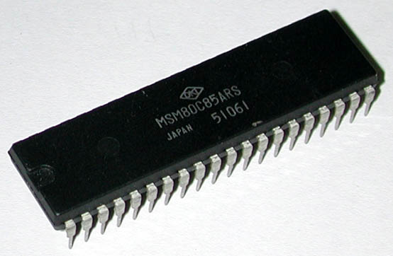
Introduction to 8085
It was introduced in 1977.
It is 8-bit microprocessor.
Its actual name is 8085 A.
It is single NMOS device.
It contains 6200 transistors approx.
Its dimensions are
164 mm x 222 mm.
It is having 40 pins Dual-Inline-Package (DIP).

Slide 3
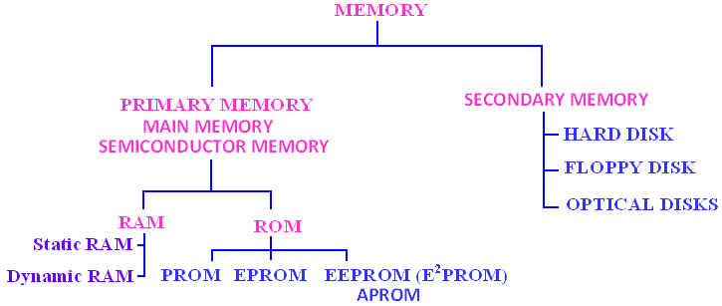
Classification of Memory

Slide 4
Types of Semiconductor Memory Devices
Read Only Memory (ROM)
A memory device that maintains its data permanently (or until the device is reprogrammed).
  Non-volatile: It maintains its data even without power supply.
Used to store
  Programs such as the BIOS.
  Data such as look tables
    e.g. the bit pattern of the characters in a dot matrix printer.
A ROM device can be
  Masked ROM (Programmed by the manufacturer)
  Programmable ROM (can be program-erased-reprogrammed many times
Random Access Memory (RAM)
A memory device that can be read and written.
  Volatile: It looses its data when the power supply is switched-off
  When the supply is switched-on it contains random data
Used to store
  User programs that are loaded from a secondary memory (disk)
  Temporary data used by programs such as variables and arrays.
A RAM device can be
  Static
  dynamic

Slide 5
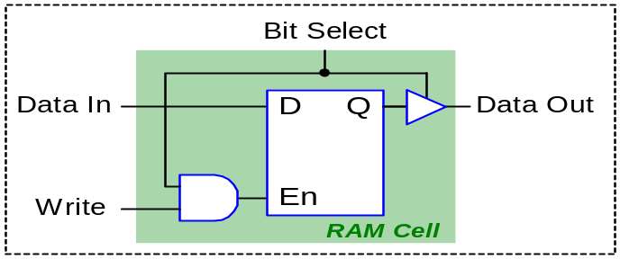
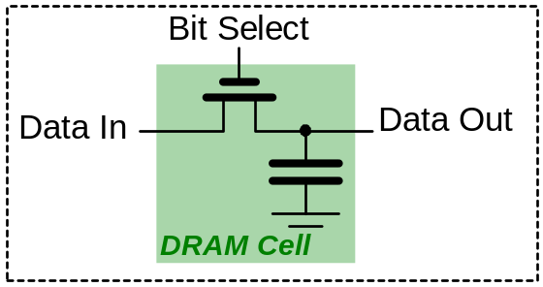
RAM Cells
Static RAM (SRAM):
The basic element of a static RAM cell is the D-Latch.
Data remains stored in the cell until it is intentionally modified.
SRAM is fast (Access time: 1ns).
SRAM needs more space on the semiconductor chip than DRAM.
  SRAM more expensive than DRAM
  SRAM needs more space than DRAM
SRAM consumes power only when accessed.
SRAM is used as a Cache
Dynamic RAM (DRAM):
DRAM stores data in the form of electric charges in capacitors.
Charges leak out, thus need to refresh data every few ms.
DRAM is slow (Access time: 60ns).
DRAM needs less space on the semiconductor chip than SRAM.
  DRAM less expensive than SRAM
  DRAM needs less space than SRAM
DRAM needs to be refreshed
DRAM is used as the main memory

Slide 6
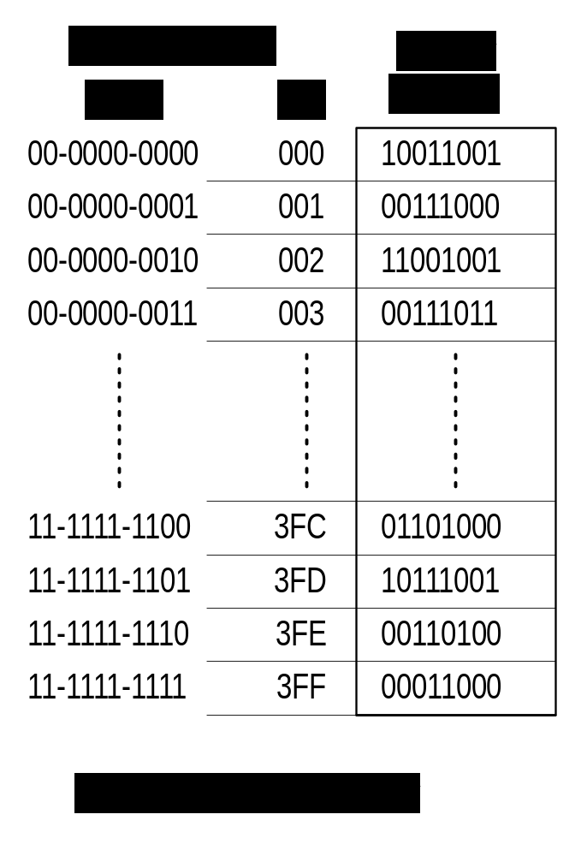
Basic Concepts
A memory device can be viewed as a single column table.
  Table index (row number) refers to the address of the memory.
  Table entries refer to the memory contents or data.
  Each table entry is referred as a memory location or as a word.
Both the memory address and the memory contents are binary numbers, expressed in most cases in Hex format.
The size of a memory device is specified as the number of memory locations X width or word size (in bits).
  For example a 1K X 8 memory device has 1024 memory locations, with a width of 8 bits.

Slide 7
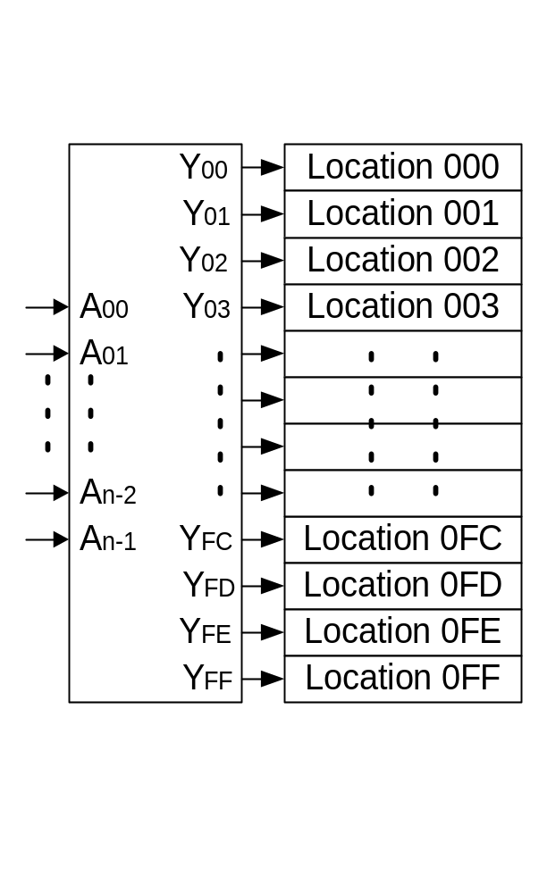
Address Lines
A memory device or memory chip must have three types of lines or connections: Address, Data, and Control.
Address Lines: The input lines that select a memory location within the memory device.
  Decoders are used, inside the memory chip, to select a specific location
  The number of address pins on a memory chip specifies the number of memory locations.
    If a memory chip has 13 address pins (A0..A12), then it has:
    2¹³ = 2³ X 2¹⁰ = 8K locations.
    If a memory chip has 4K locations, then it should have N pins:
    2^{N} = 4K = 2² X 2¹⁰ = 2¹² → N=12 address pins (A0..A11)

Slide 8
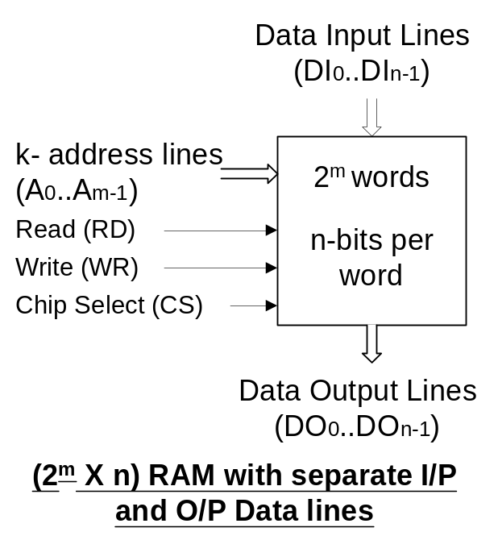
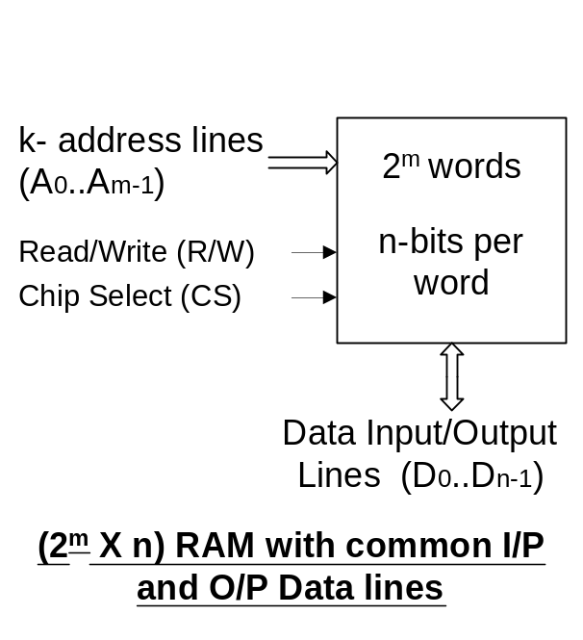
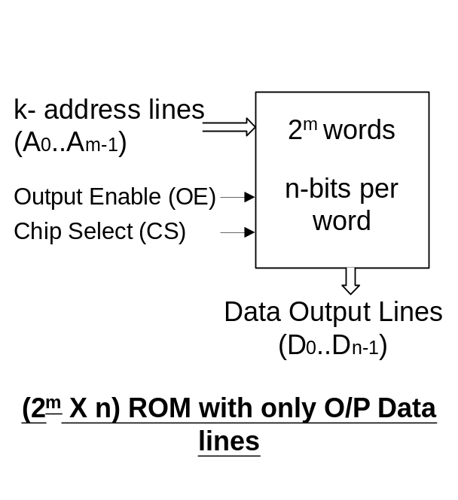
Data Lines
Data Connections: All memory devices have a set of data output pins (for ROM devices), or input/output pins (for RAM devices).
  Most RAM chips have common bi-directional I/O connections.
  Most memory devices have 1, 8 or 16 data lines.

Slide 9
Control Lines
Enable Connections:
  All memory devices have at least one Chip Select (CS) or Chip Enable (CE) input, used to select or enable the memory device.
    If a device is not selected or enabled then no data can be read from, or written into it.
    The CS or CE input is usually controlled by the microprocessor through the higher address lines via an address decoding circuit.
Control Connections:
  RAM chips have two control input signals that specify the type of memory operation: the Read (RD) and the Write (WR) signals.
    Some RAM chips have a common Read/ Write (R/W) signal.
  ROM chips can perform only memory read operations, thus there is no need for a Write (WR) signal.
    In most real ROM devices the Read signal is called the Output Enable (OE) signal.

Slide 10
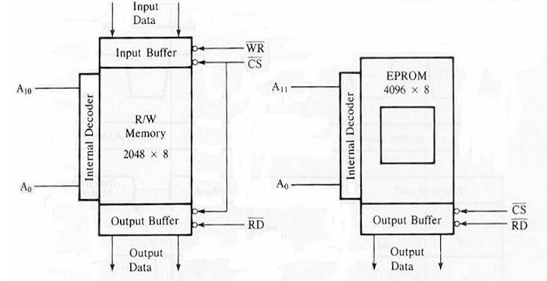
Requirement and structure of memory

Slide 11
Interfacing Memory
  Accessing memory can be summarized into the following three steps:
      Select the chip.
      Identify the memory register.
      Enable the appropriate buffer.
  Translating this to microprocessor domain:
      The microprocessor places a 16-bit address on the address bus.
      Part of the address bus will select the chip and the other part will go through the address decoder to select the register.
      The signals IO/M and RD combined indicate that a memory read operation is in progress. The MEMR signal can be used to enable the RD line on the memory chip.

Slide 12
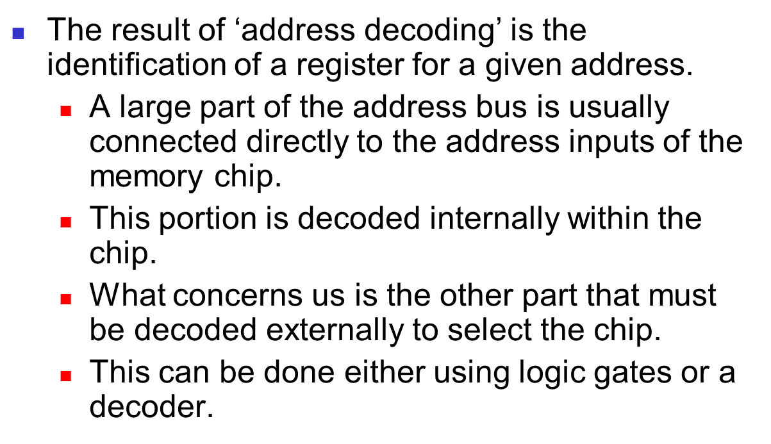
Address decoding

Slide 13
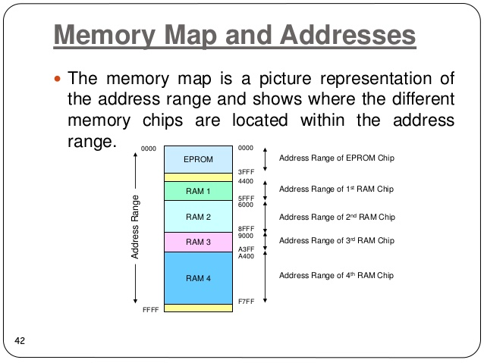
Memory Map
Maninder Kaur

Slide 14
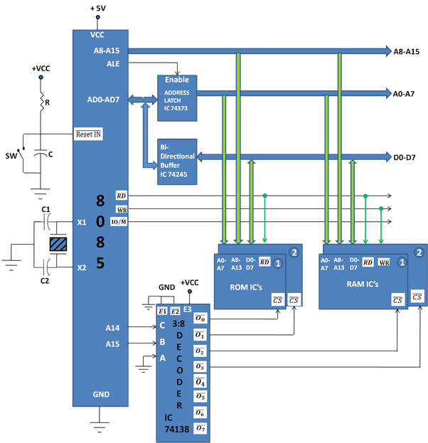
Design a minimum system to interface the following specification.
32K of RAM using 2x16kb RAM Ic
32kB of RAM using 2x16kb ROM ic
Maninder Kaur

Slide 15
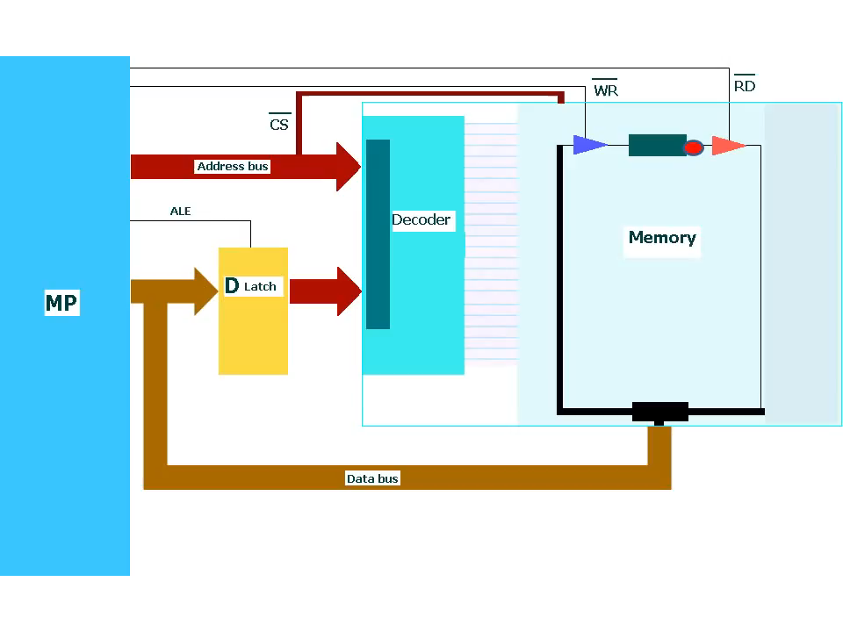
Memory Read operation

Slide 16
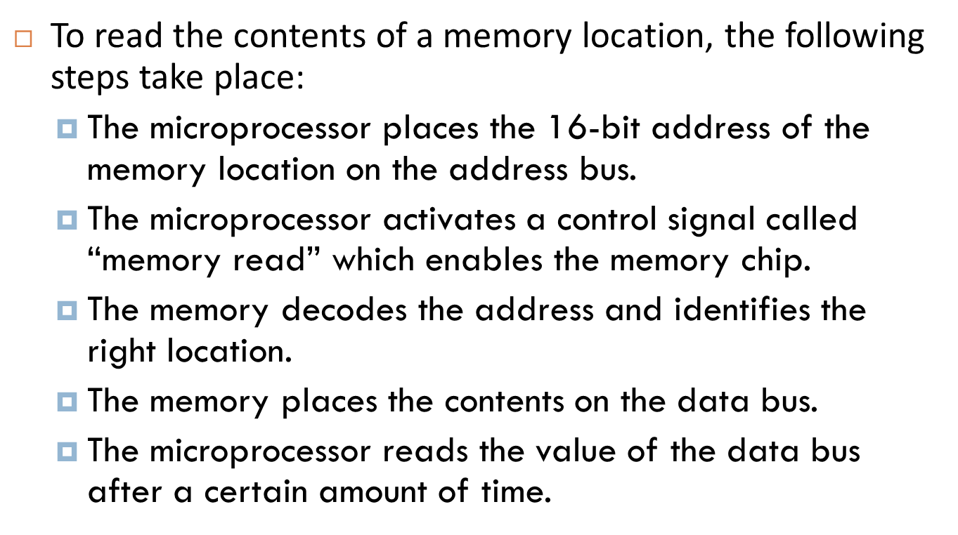
Memory Read operation

Slide 17
Memory Write operation
The following sequence of event occurs when microprocessor writes into a particular memory location.
The microprocessor sends an address of memory location into MAR using address bus.
The microprocessor also send the data into MBR.
At the same time, microprocessor sends write signal to activate memory for write operation.
The memory device will store the data stored into MBR into the location whose address is in MAR.

Slide 18
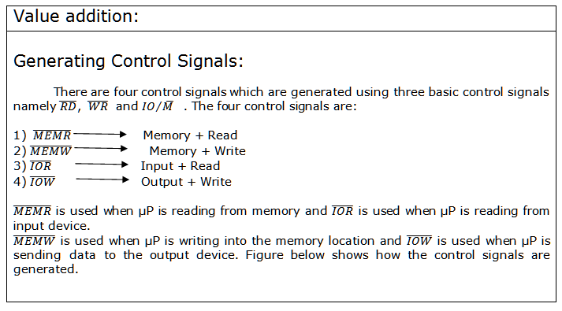


Slide 19
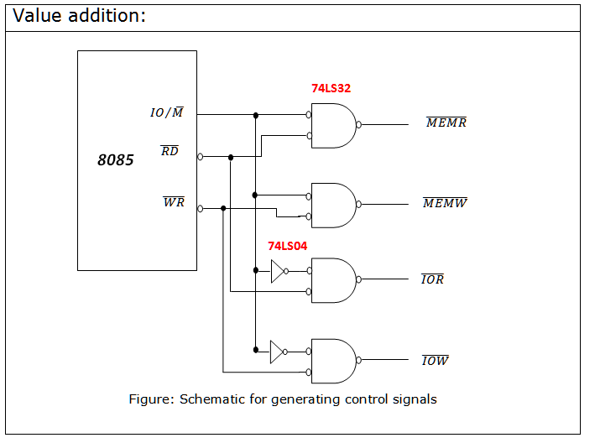

Slide 20
TIMING DIAGRAM
Timing Diagram is a graphical representation.
It represents the execution time taken by each instruction in a graphical format.
The execution time is represented in
T-states.

Slide 21
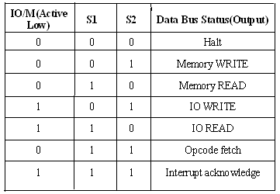
CONTROL SIGNALS

Slide 22
INSTRUCTION CYCLE
The time required to execute an instruction is called instruction cycle.

Slide 23
MACHINE CYCLE
The time required to access the memory or input/output devices is called machine cycle.

Slide 24
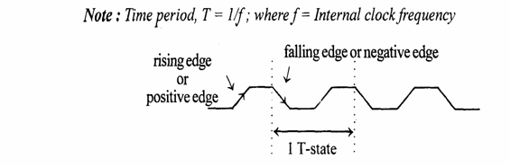
T-STATE
The machine cycle and instruction cycle takes multiple clock periods.
A portion of an operation carried out in one system clock period is called as T-state.

Slide 25
MACHINE CYCLES OF 8085
The 8085 microprocessor has 5 basic machine cycles.
They are
Opcode fetch cycle (4T)
Memory read cycle (3 T)
Memory write cycle (3 T)
I/O read cycle (3 T)
I/O write cycle (3 T)

Slide 26
MACHINE CYCLES OF 8085
The processor takes a definite time to execute the machine cycles. The time taken by the processor to execute a machine cycle is expressed in T-states.
One T-state is equal to the time period of the internal clock signal of the processor.
The T-state starts at the falling edge of a clock.

Slide 27
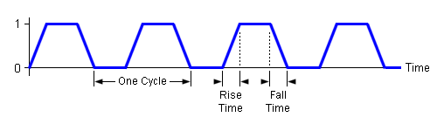
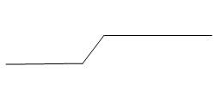
Representation of signals in Timing Diagram
1.Clock Signals:-As we know that the microprocessor operates with reference to clock signals provided to it. At pins X1 and X2 we provide clock signals and this frequency is divided by two. This frequency is called as the operating frequency.
2.Single Line Signal:-The status of single line will be either LOW or HIGH. But the change from one state to another state is not possible in zero time.
3.Multiple Line Signals:-In Microprocessor we have multiple lines. These signals are also called as bus signals. If a single line changes occur then we have to show a crossing to indicate change in contents
Tri-state
change
Valid
Valid

Slide 28
Representation of signals in Timing Diagram
4. Single line and single effect single:- because of single line the other signal also changes. A changes cause change in other signal it is shown with an arrow.
5. Multiple line and single effect single:- if changes in multiple lines cause change in other signal it is shown with an arrow.

Slide 29
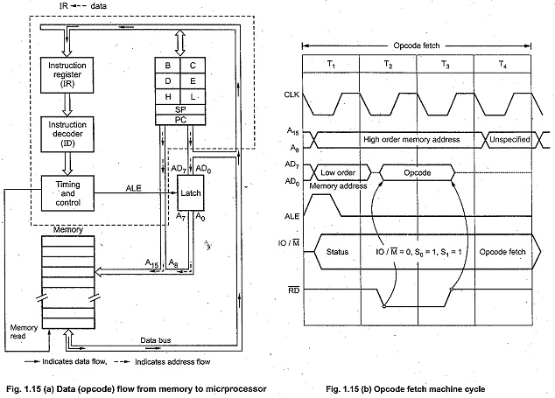
Op code fetching Machine cycle

Slide 30
Op-code fetching Machine cycle
In T1 state, the 8085 places the contents of program counter on the address bus.
The high-order byte of the PC is placed on the A8-A15 lines. The low-order byte of the PC is placed on the AD0 – AD7 lines which stays on only during T1.
Microprocessor activates ALE (Address Latch Enable) which is used to latch the low-order byte of the address in external latch before it disappears.
In T1, 8085 also sends status signals IO/M, S1, and S0. IO/M specifies whether it is a memory or I/O operation,
In T₂, low-order address disappears from the AD₀ – AD₇ lines. (However A_{o} – A₇remain available as they were latched during T₁). In T₂, 8085 sends RD signal low to enable the addressed memory location. The memory device then places the contents of addressed memory location on the data bus (AD_{o} – AD₇).
During T₃, 8085 loads the data from the data bus in its Instruction Register and raises RD to high which disables the memory device.
In T₄, microprocessor decodes the opcode, and on the basis of the instruction received, it decides whether to enter state T₅ or to enter state T₁ of the next machine cycle One byte instructions those operate on eight bit data (8 bit operand) are executed in T₄.

Slide 31
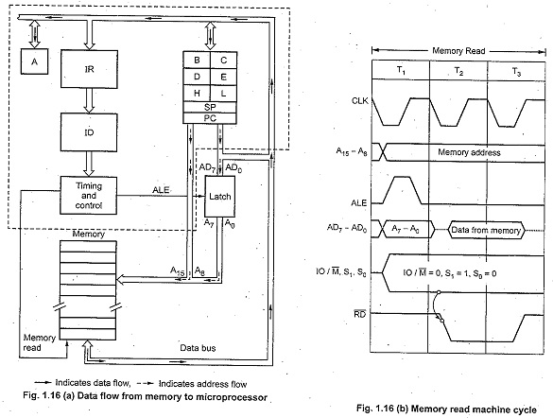
Memory read Machine cycle

Slide 32
Memory read Machine cycle
The MP places the 16-bit memory address from the program counter on address bus. At time period T1, the higher order memory address is placed on the address lines A15 – A8. When ALE is high, the lower address is placed on the bus AD7 – AD0. The status signal IO/M(bar) goes low indicating the memory operation and two status signals S1 = 1, S0 = 0 to indicate memory read operation.
At time period T2, the MP sends RD(bar) control line to enable the memory read. When memory is enabled with RD(bar) signal, the data from the addressed memory location is placed on the data bus with ALE low.
The data is reached at processor register during T3 state. When data is arrived, the RD(bar) signal goes high. It causes the bus to go into high impedance state.

Slide 33
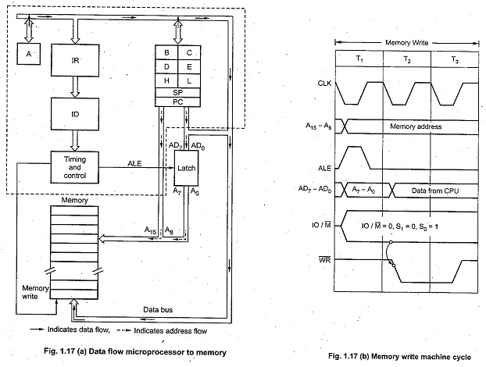
Memory Write Machine cycle

Slide 34
Memory Write Machine cycle
In T₁ state, the 8085 places the address on the address lines from stack pointer or general purpose register pair and activates ALE signal in order to latch low-order byte of address. During T₁, 8085 sends status signals : IO/M = 0, S₁ = 0 and S₀ = 1 for memory write machine cycle.
In T₂, 8085 places data on the data bus and sends WR signal low for writing into the addressed memory location.
During T₃, WR signal goes high, which disables the memory device and terminates the write operation.

Slide 35
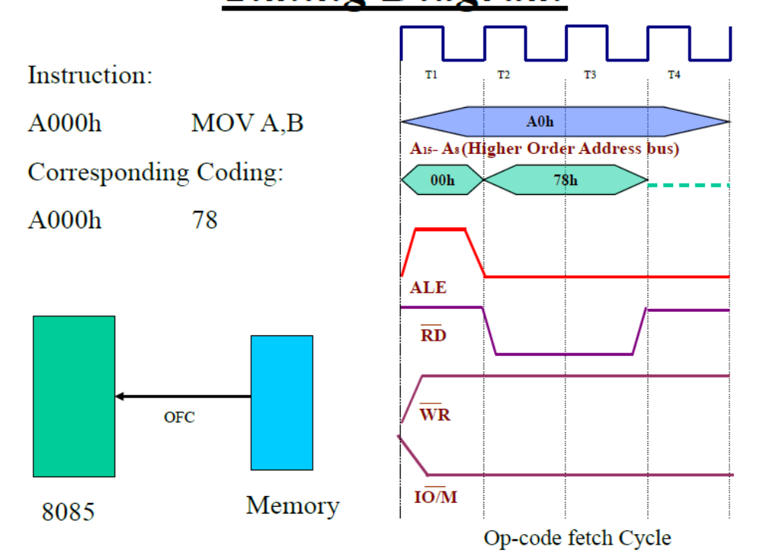

Slide 36
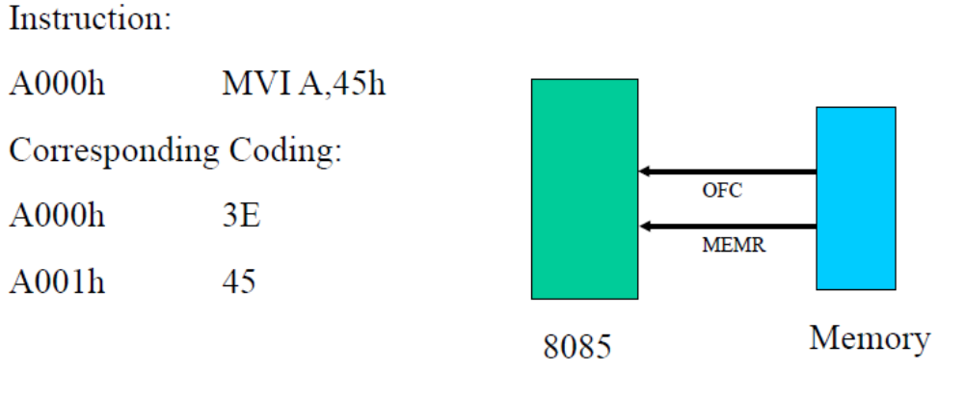

Slide 37
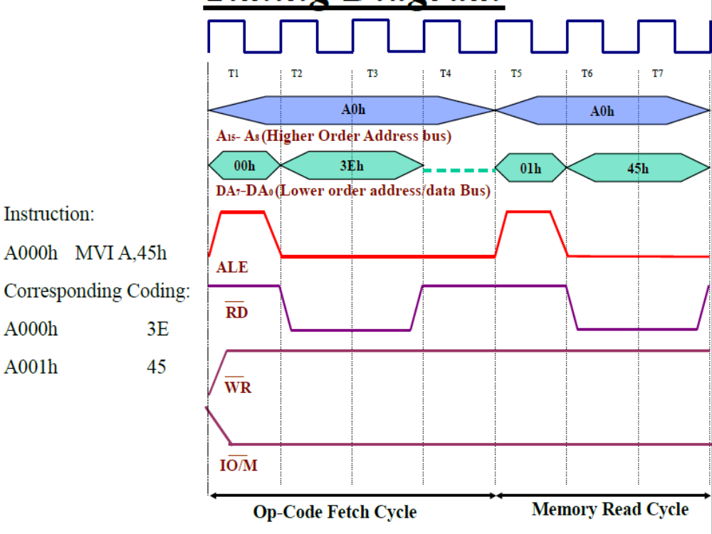

Slide 38
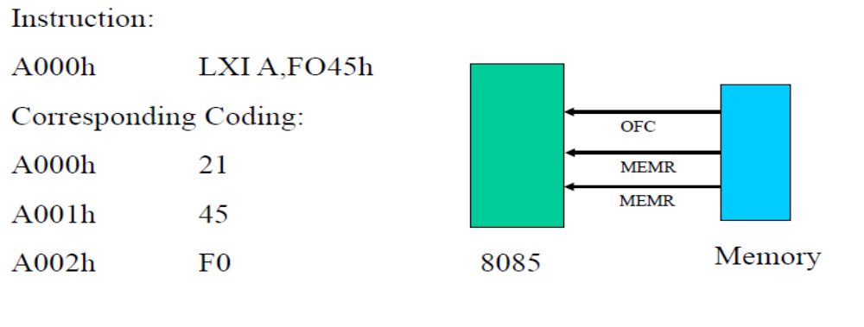

Slide 39
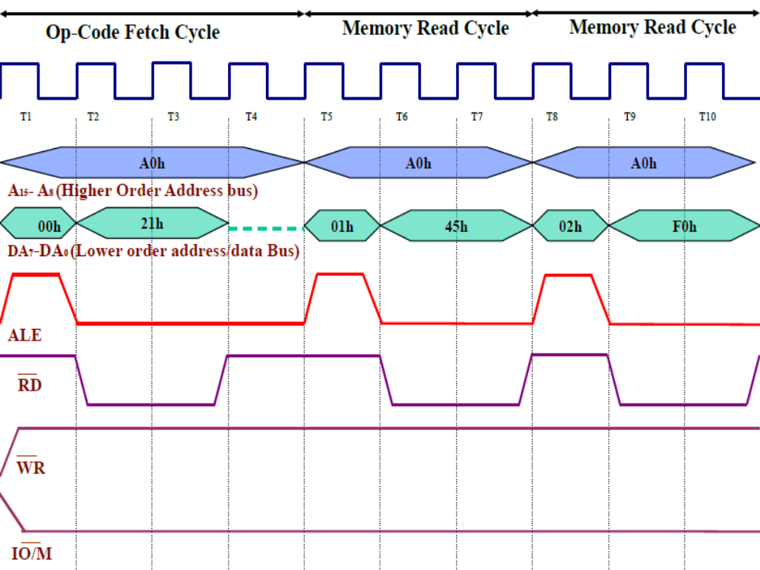

Slide 40
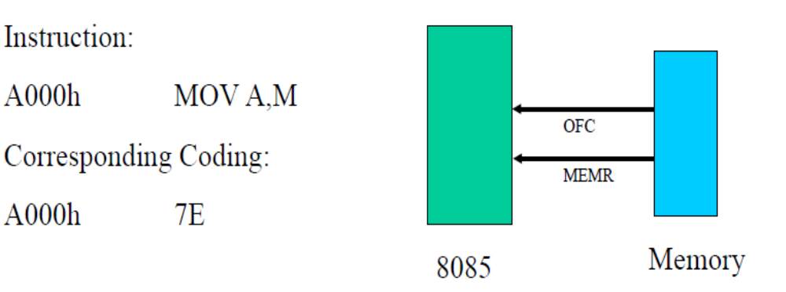

Slide 41
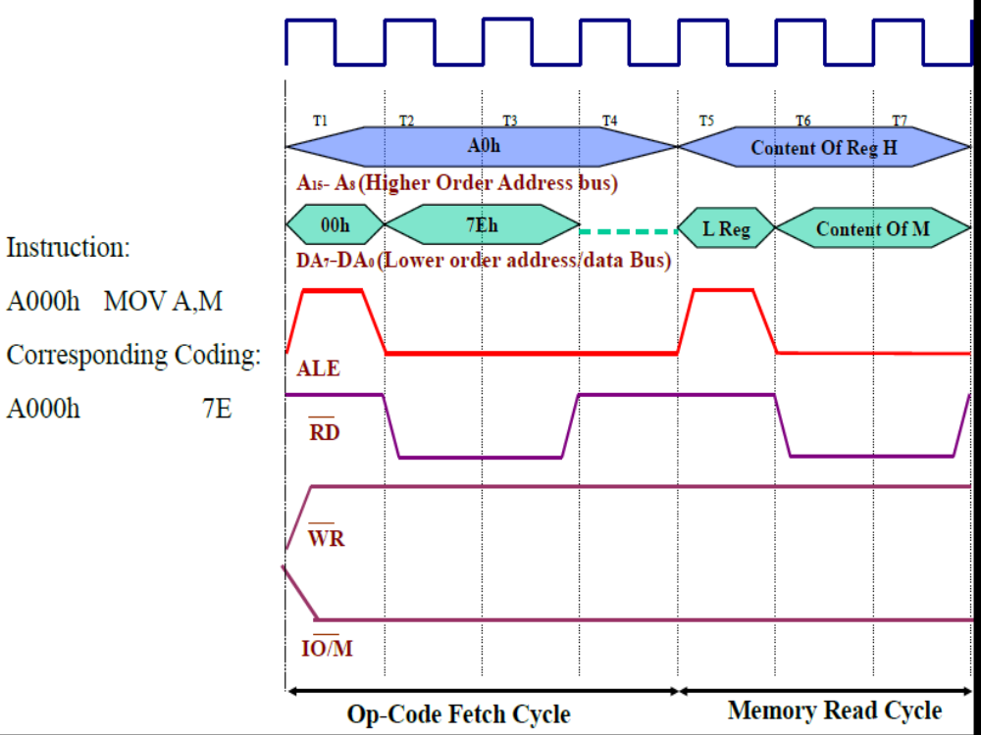

Slide 42
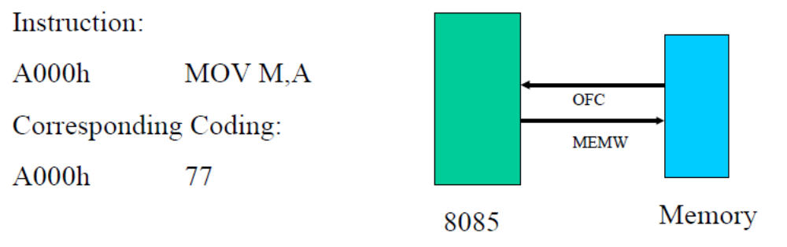


Slide 43
Interfacing I/O devices with 8085
I/O
Interface
I/O
Devices
8085
System Bus
Memory
Interface
Memory
Devices

Slide 44
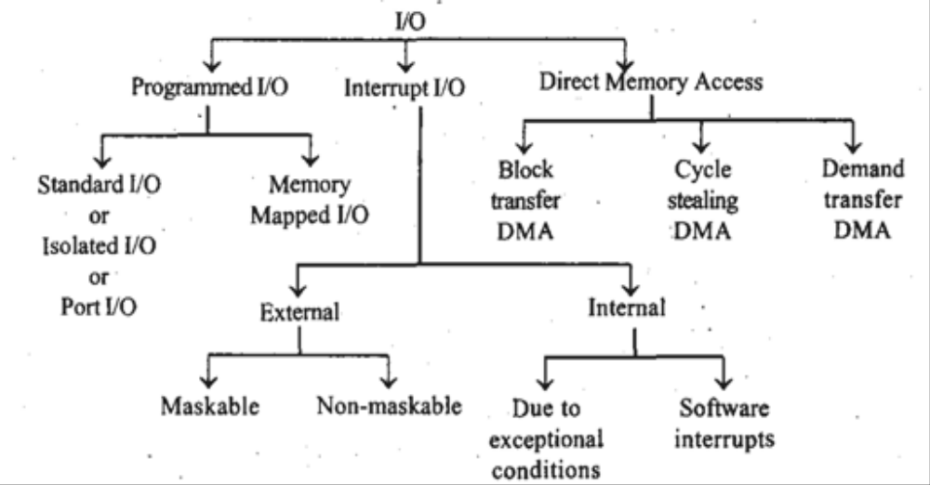
Classification of I/O devices
Maninder Kaur

Slide 45
Techniques for I/O Interfacing
Memory-mapped I/O
Peripheral-mapped I/O

Slide 46
Memory-mapped I/O
8085 uses its 16-bit address bus to identify a memory location
Memory address space: 0000H to FFFFH
8085 needs to identify I/O devices also
I/O devices can be interfaced using addresses from memory space
8085 treats such an I/O device as a memory location
This is called Memory-mapped I/O

Slide 47
Peripheral-mapped I/O
8085 has a separate 8-bit addressing scheme for I/O devices
I/O address space: 00H to FFH
This is called Peripheral-mapped I/O or I/O-mapped I/O

Slide 48
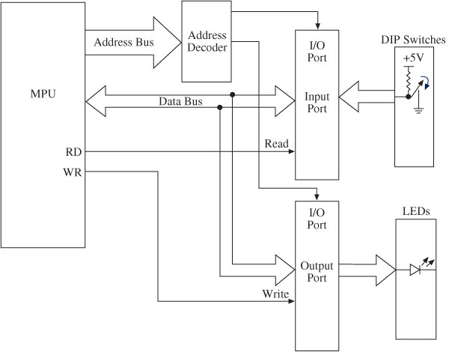
Maninder Kaur

Slide 49
8085 Communication with I/O devices
Involves the following three steps
  Identify the I/O device (with address)
  Generate Timing & Control signals
  Data transfer takes place
8085 communicates with a I/O device only if there is a Program Instruction to do so

Slide 50
1.Identify the I/O device (with address)
Memory-mapped I/O (16-bit address)
Peripheral-mapped I/O (8-bit address)
2.Generate Timing & Control Signals
Memory-mapped I/O
  Reading Input: IO/M = 0, RD = 0
  Write to Output: IO/M = 0, WR = 0
Peripheral-mapped I/O
  Reading Input: IO/M = 1, RD = 0
  Write to Output: IO/M = 1, WR = 0
3. Data transfer takes place

Slide 51
Peripheral I/O Instructions
IN Instruction
  Inputs data from input device into the accumulator
  It is a 2-byte instruction
  Format: IN 8-bit port address
  Example: IN 01H
OUT Instruction
  Outputs the contents of accumulator to an output device
  It is a 2-byte instruction
  Format: OUT 8-bit port address
  Example: OUT 02H

Slide 52
----------Example Program----------
WAP to read a number from input port (port address 01H) and display it on ASCII display connected to output port (port address 02H)
IN 01H ;reads data value 03H (example)into ;accumulator, A = 03H
MVI B, 30H ;loads register B with 30H
ADD B ;A = 33H, ASCII code for 3
OUT 02H ;display 3 on ASCII display

Slide 53
Memory-mapped I/O Instructions
I/O devices are identified by 16-bit addresses
8085 communicates with an I/O device as if it were one of the memory locations
Memory related instructions are used
For e.g. LDA, STA
LDA 8000H
  Loads A with data read from input device with 16-bit address 8000H
STA 8001H
  Stores (Outputs) contents of A to output device with 16-bit address 8001H

Slide 54
----------Example Program----------
WAP to read a number from input port (port address 8000H) and display it on ASCII display connected to output port (port address 8001H)
LDA 8000H ;reads data value 03H (example)into ;accumulator, A = 03H
MVI B, 30H ;loads register B with 30H
ADD B ;A = 33H, ASCII code for 3
STA 8001H ;display 3 on ASCII display

Slide 55
I/O read/write Machine cycle
The I/O read and I/O write machine cycles are similar to the memory read and memory write machine cycles, respectively, except that the I0/M signal is high for I/O read and I/O write machine cycles. High IO/M signal indicates that it is an I/O operation.

Slide 56
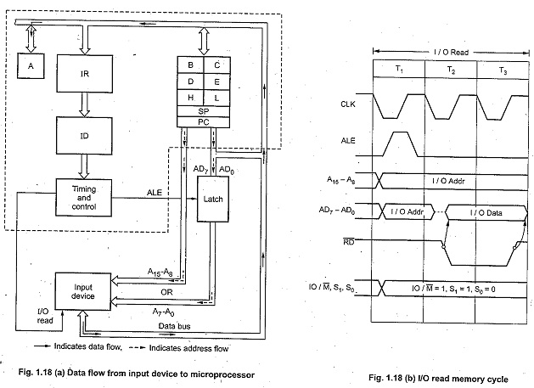
I/O read Machine cycle

Slide 57
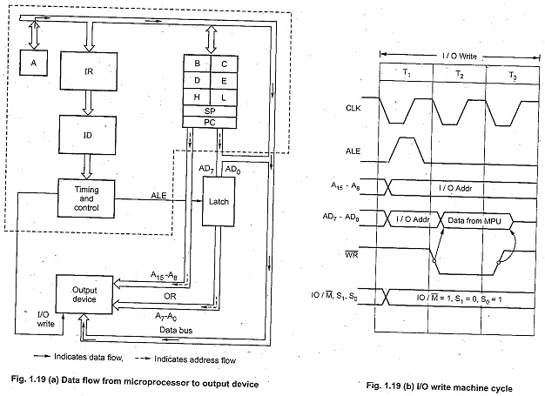
I/O Write Machine cycle

Slide 58
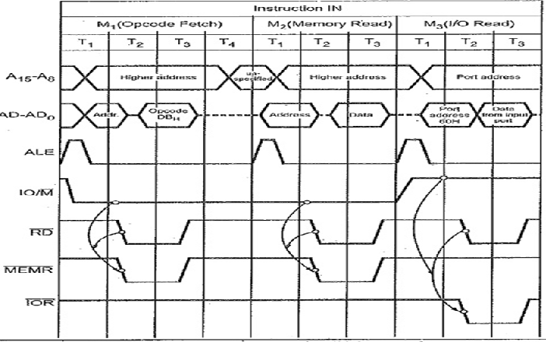
IN 8-bit port address
Maninder Kaur

Slide 59
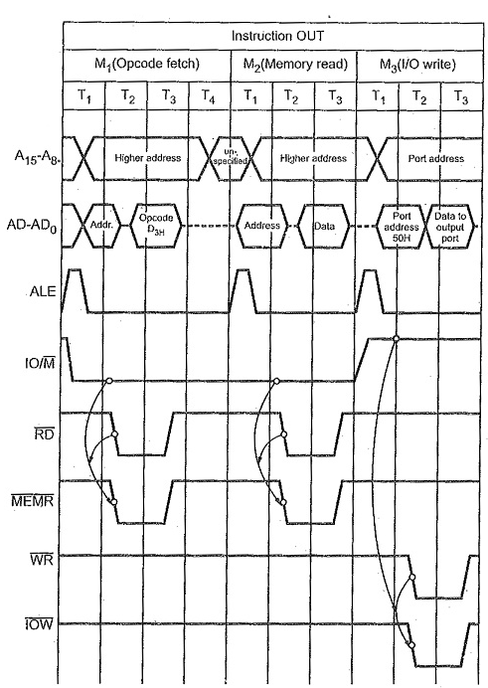
Out 8bit port address
Maninder Kaur

Slide 60
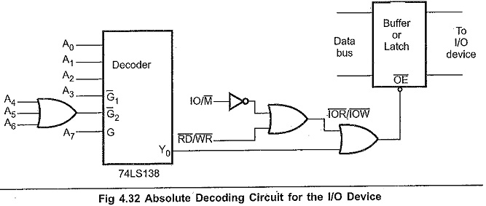
I/O device selection
the 8085 gives 8 bit I/O address. This means it can select one of the 256 I/O ports. To select an appropriate I/O device, it is necessary to do following things.
1. Decode the address to generate unique signal corresponding to the device address on the bus.
2. When device address signal and control signal (IOR or IOW) both are low, generate device select signal.
3. Use device select signal to activate the Input Output Interfacing Techniques.
device select signal
Maninder Kaur

Slide 61
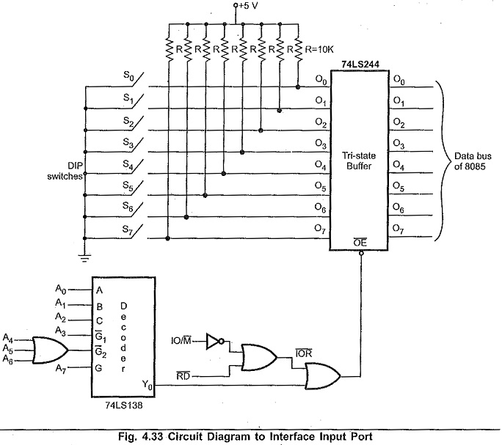
Input device
Maninder Kaur

Slide 62
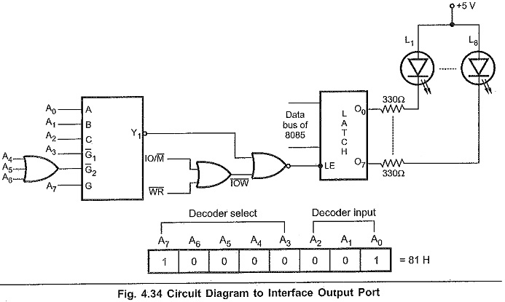
Output device
Maninder Kaur

Slide 63
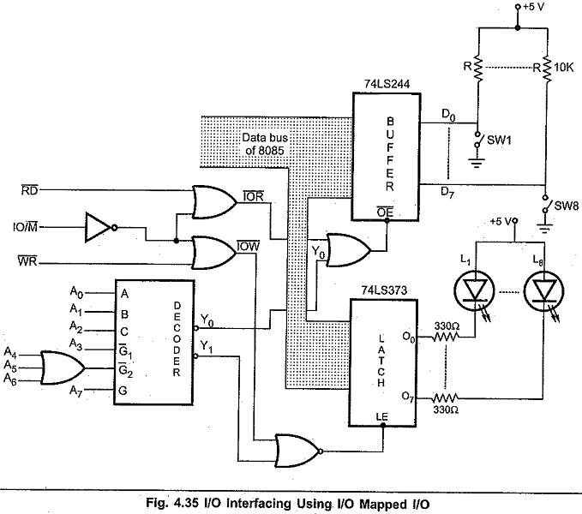
Memory mapped I/O
Maninder Kaur

Slide 64
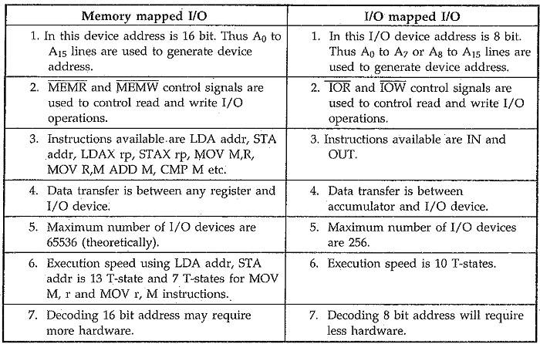
Maninder Kaur

Slide 65
Thank You

